Slide 1
Chapter 14 More on transaction processing
Topics:
Cascading rollback, recoverable schedule
Deadlocks
Prevention
Detection
View serializability
Distributed transactions
Long transactions (nested, compensation)

Slide 2
Concurrency control & recovery
Example: Tj Ti
Wj(A)
ri(A) Commit Ti
Abort Tj
 Non-Persistent Commit (Bad!)
…
… …
… …
…

Slide 3
Concurrency control & recovery
Example: Tj Ti
Wj(A)
ri(A) Commit Ti
Abort Tj
…
… …
… …
…
avoided by recoverable schedules
 Non-Persistent Commit (Bad!)

Slide 4
Concurrency control & recovery
Example: Tj Ti
Wj(A)
ri(A)
wi(B)
Abort Tj
[Commit Ti]
 Cascading rollback (Bad!)
…
… …
… …
…

Slide 5
Concurrency control & recovery
Example: Tj Ti
Wj(A)
ri(A)
wi(B)
Abort Tj
…
… …
… …
…
[Commit Ti] avoided by
 Cascading rollback (Bad!)
avoids-cascading- rollback (ACR)
schedules
CS 245
Notes 10
5

Slide 6
Schedule is conflict serializable
Tj Ti
But not recoverable

Slide 7
Need to make “final’ decision for each transaction:
commit decision - system guarantees transaction will or has completed, no matter what
abort decision - system guarantees transaction will or has been rolled back (has no effect)

Slide 8
To model this, two new actions:
Ci - transaction Ti commits
Ai - transaction Ti aborts

Slide 9
Back to example:
Tj Ti
Wj(A)
ri(A)
Ci ← can we commit
here?
...
...
...
...

Slide 10
Definition
Ti reads from Tj in S (Tj ⇒_{S} Ti) if
wj(A) <_{S} ri(A)
aj <_{S} ri(A) (< : does not precede)
If wj(A) <_{S} wk(A) <_{S} ri(A) then ak <_{S} ri(A)

Slide 11
Definition
Schedule S is recoverable if
whenever Tj | ⇒_{S} Ti | and | j ≠ i and Ci ∈ S
then Cj <_{S} | Ci

Slide 12
Note: in transactions, reads and writes precede commit or abort
If Ci ∈ Ti, then ri(A) < Ci
wi(A) < Ci If Ai ∈ Ti, then ri(A) < Ai
wi(A) < Ai
Also, one of Ci, Ai per transaction

Slide 13
How to achieve recoverable schedules?

Slide 14
With 2PL, hold write locks to commit (strict 2PL)
Tj Ti
Wj(A)
Cj uj(A)
ri(A)
...
... ...
...
... ...
...

Slide 15
With validation, no change!

Slide 16
S is recoverable if each transaction commitsonly after all transactions from which it read have committed.
S avoids cascading rollback if each transaction may readonly those values written by committed transactions.

Slide 17
S is strict if each transaction may read andwriteonly items previously written by committed transactions.
RC
ST
SERIAL
Avoids cascading rollback
ACR

Slide 18
Where are serializable schedules?
RC
ST
SERIAL
Avoids cascading rollback
ACR

Slide 19
Examples
Recoverable:
w₁(A) w₁(B) w₂(A) r₂(B) c₁ c₂
Avoids Cascading Rollback:
w₁(A) w₁(B) w₂(A) c₁ r₂(B) c₂
Strict:
Assumes w₂(A) is done without reading
w₁(A) w₁(B) c₁ w₂(A) r₂(B) c₂

Slide 20
Deadlocks
Detection
Wait-for graph
Prevention
Resource ordering
Timeout
Wait-die
Wound-wait

Slide 21
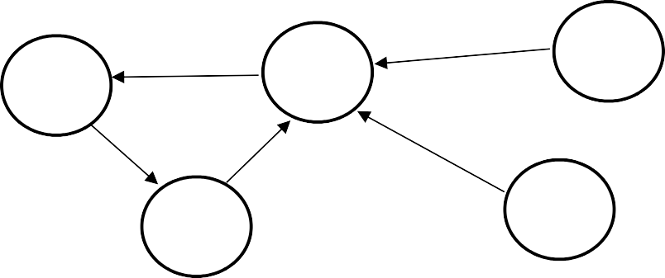


Deadlock Detection
Build Wait-For graph
Use lock table structures
Build incrementally or periodically
When cycle found, rollback victim
T2
T5
T1
T7
T4
T3
T6

Slide 22
Resource Ordering
Order all elements A1, A2, …, An
A transaction T can lock Ai after Aj only if i > j
Problem : Ordered lock requests not realistic in most cases

Slide 23
Timeout
If transaction waits more than L sec., roll it back!
Simple scheme
Hard to select L

Slide 24
Wait-die
Transactions given a timestamp when they arrive …. ts(Ti)
Ti can only wait for Tj if ts(Ti)< ts(Tj)
...else die

Slide 25
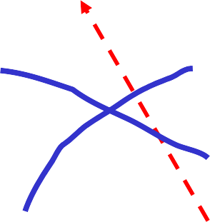
Example:
T1
(ts =10)
wait
T2
(ts =20)
wait?
wait
T3
(ts =25)

Slide 26
Starvation with Wait-Die
When transaction dies, re-try later with what timestamp?
original timestamp
new timestamp (time of re-submit)

Slide 27
Starvation with Wait-Die
Resubmit with original timestamp
Guarantees no starvation
Transaction with oldest ts never dies
A transaction that dies will eventually have oldest ts and will complete...

Slide 28
Second Example:
T1
(ts =22)
requests A: wait for T₂ or T₃?
T2
(ts =20)
Note: ts between 20 and 25.
wait(A)
T3
(ts =25)

Slide 29
Second Example (continued):
One option: T₁ waits just for T₃, transaction holding lock. But when T₂ gets lock, T₁ will have to die!
T1
(ts =22)
T2
wait(A)
(ts =20)
wait(A)
T3
(ts =25)

Slide 30
Second Example (continued):
Another option: T₁ only gets A lock after T₂, T₃ complete, so T₁ waits for both T₂, T₃ ⇒ T₁ dies right away!
T1
(ts =22)
wait(A)
T2
(ts =20)
wait(A)
wait(A)
T3
(ts =25)

Slide 31
Second Example (continued):
Yet another option: T₁ preempts T₂, so T₁ only waits for T₃; T₂ then waits for T₃ and T₁... ⇒ T₂ may starve?
T1
(ts =22)
wait(A) _{T2}
wait(A)
(ts =20)
wait(A)
T3
(ts =25)
redundant arc

Slide 32
Wound-wait
Transactions given a timestamp when they arrive … ts(Ti)
Ti wounds Tj if ts(Ti)< ts(Tj)
else Ti waits
“Wound”: Tj rolls back and gives lock to Ti

Slide 33
Example:
T1
(ts =25)
wait
T2
wait
(ts =20)
wait
T3
(ts =10)

Slide 34
Starvation with Wound-Wait
When transaction dies, re-try later with what timestamp?
original timestamp
new timestamp (time of re-submit)

Slide 35
Second Example:
T1
(ts =15)
requests A: wait for T₂ or T₃?
T2
(ts =20)
Note: ts between 10 and 20.
wait(A)
T3
(ts =10)

Slide 36
Second Example (continued):
One option: T₁ waits just for T₃, transaction holding lock. But when T₂ gets lock, T₁ waits for T₂ and wounds T₂.
T1
(ts =15)
wait(A)
T2
(ts =20)
wait(A)
T3
(ts =10)

Slide 37
Second Example (continued):
Another option: T₁ only gets A lock after T₂, T₃ complete, so T₁ waits for both T₂, T₃ ⇒ T₂ wounded right away!
T1
(ts =15)
wait(A)
T2
(ts =20)
wait(A)
wait(A)
T3
(ts =10)

Slide 38
Second Example (continued):
Yet another option: T₁ preempts T₂, so T₁ only waits for T₃; T₂ then waits for T₃ and T₁... ⇒ T₂ is spared!
T1
(ts =15)
wait(A)
T2
(ts =20)
wait(A)
wait(A)
T3
(ts =10)

Slide 39
User/Program commands
Lots of variations, but in general
Begin_work
Commit_work
Abort_work

Slide 40
Nested transactions
User program:
Begin_work;
If results_ok, then commit work else abort_work
...
...
...

Slide 41
Nested transactions
User program:
Begin_work;
Begin_work;
If results_ok, then commit work
else {abort_work; try something else…}
If results_ok, then commit work else abort_work
...
...
...

Slide 42
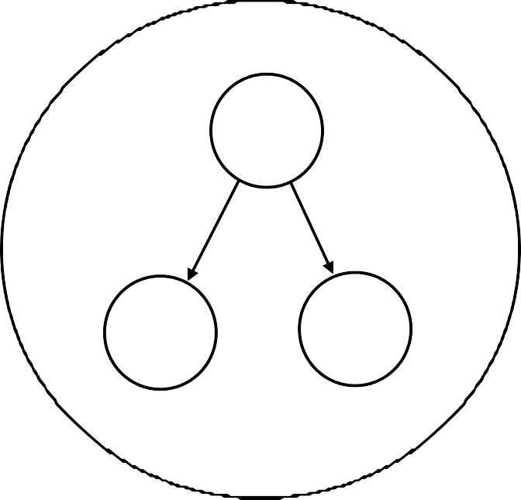
Parallel Nested Transactions
T₁: begin-work
...
parallel:
begin_work commit_work begin_work commit_work
T
T₁₁:
T
1
...
1
^{T}11
^{T}12
T₁₂:
...
...
commit_work

Slide 43

Locking
Locking
What are we really locking?

Slide 44
Example:
Ti
Read record r1
...
...
Read record r1
do record locking
...
Modify record r3
...

Slide 45
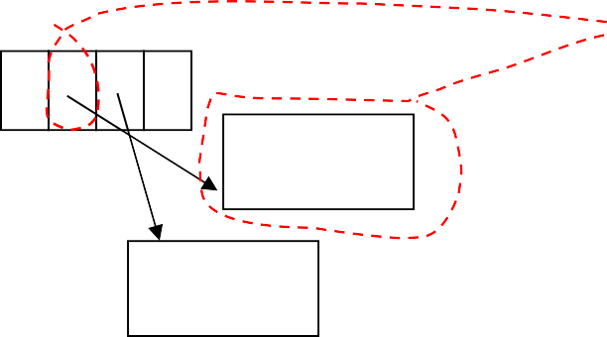
But underneath:
If we lock all
data involved in read of R1, we may prevent an update to R2 (which may require reorganization within block)
record id
R1
R2
R3
Disk pages

Slide 46
Solution: view DB at two levels
Top level: record actions
record locks
undo/redo actions — logical
e.g., Insert record(X,Y,Z) Redo: insert(X,Y,Z) Undo: delete

Slide 47
Low level: deal with physical details
latch page during action (release at end of action)

Slide 48



Note: undo does not return physical DB to original state; only same logical state
e.g., Insert R3 Undo (delete R3)
R1
R1 R2
R3
R1 R2
R2

Slide 49
Logging Logical Actions
Logical action typically span one block (physiological actions)
Undo/redo log entry specifies undo/redo logical action
Challenge: making actions idempotent
Example (bad): redo insert ⇒
key inserted multiple times!

Slide 50


Solution: Add Log Sequence Number
sem | lsn=25 | ...
3, v1
Log record:
LSN=26
OP=insert(5,v2)
into P
...
sem | lsn=26 | ...
3, v1 5, v2

Slide 51




Still Have a Problem!
Make log entry for undo
lsn=27
lsn=?? ...
lsn=24 ...
lsn=25 ...
lsn=26 ...
3, v1
4, v2
3, v1
3, v1
5, v3
3, v1
5, v3
4, v2
T1
Del 4
T2
Ins 5
undo Del 4

Slide 52
Compensation Log Records
Log record to indicate undo (not redo) action performed
Note: Compensation may not return page to exactly the initial state

Slide 53
At Recovery: Example
Log:
... | lsn=21 T1 a1 p1 | ... | lsn=27 T1 a2 p2 | ... | lsn=35 T1 _{a2}-1 p2 | ...

Slide 54
What to do with p2 (during T1 rollback)?
If lsn(p2)<27 then ... ?
If 27 ≤ lsn(p2) < 35 then ... ?
If lsn(p2) ≥ 35 then ... ?
Note: lsn(p2) is lsn of p copy on disk

Slide 55
Recovery Strategy
[1] Reconstruct state at time of crash
Find latest valid checkpoint, Ck, and let ac
be its set of active transactions
Scan log from Ckto end:
For each log entry [lsn, page] do: if lsn(page) < lsn then redo action
If log entry is start or commit, update ac

Slide 56
Recovery Strategy
[2] Abort uncommitted transactions
Set ac contains transactions to abort
Scan log from end to Ck:
For each log entry (not undo) of an ac
transaction,
undo action (making log entry)
For ac transactions not fully aborted, read their log entries older than Ckand undo their actions

Slide 57
Example: What To Do After Crash
Log:
chk pt | ... | lsn=21 T1 a1 p1 | ... | lsn=27 T1 a2 p2 | ... | lsn=29 T1 a3 p3 | ... | lsn=31 T1 _{a3}-1 p3 | ... | lsn=35 T1 _{a2}-1 p2 | ...

Slide 58


During Undo: Skip Undo’s
Log:
pointer to forward action
...
lsn=21 T1
a1 p1
lsn=27 T1
a2 p2
lsn=29 T1
a3 p3
lsn=31
T1 _{a3}-1
... p3 ...
lsn=35
T1 _{a2}-1
p2
chk pt
...
...
...
pointer to previous T1 action

Slide 59
Related idea: Sagas
Long running activity: T₁, T₂, ... T_{n}
Each step/trasnaction Ti has a compensating transaction Ti-1
Semantic atomicity: execute one of
T₁, T₂, ... T_{n}
T₁, T₂, ... T_{n-1} T⁻¹ , T⁻¹ , ... T⁻¹
n-1 n-2 1
T₁, T₂, ... T_{n-2}
_{T}-1 -1 -1 _{n-2}, T _{n-3}, ... T ₁
...
T₁, T⁻¹
1
nothing

Slide 60






SQL Server Recovery Process
BEGIN
BEGIN
COMMIT
BEGIN
CHECKPOINT
BEGIN
BEGIN
COMMIT
COMMIT BEGIN
COMMIT
COMMIT
Committed transactions are rolled forward and written to the database
Uncommitted transactions are rolled back and are not written to the database

Slide 61
Summary
Cascading rollback Recoverable schedule
Deadlock
Prevention
Detectoin
Nested transactions
Multi-level view
CS 245
Notes 10
61

